Slide 1
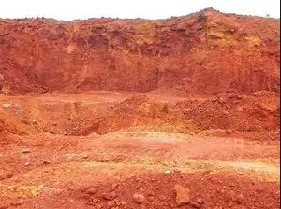
Bauxite Evaluation Services
Dr Greg Power
Arriba Consulting Pty Ltd
January 2018

Slide 2
Introducing Arriba Consulting Bauxite Evaluation Services
Arriba offers a unique service for the evaluation of new and existing bauxite deposits
Our consultants are world leaders in bauxite research and Bayer process technology
We:
Tailor investigations to the client’s needs
Co-ordinate specialist analysis and research in hand-picked, world-leading laboratories
Critically analyse and report on the results
Provide direction and advice based on the evidence

Slide 3
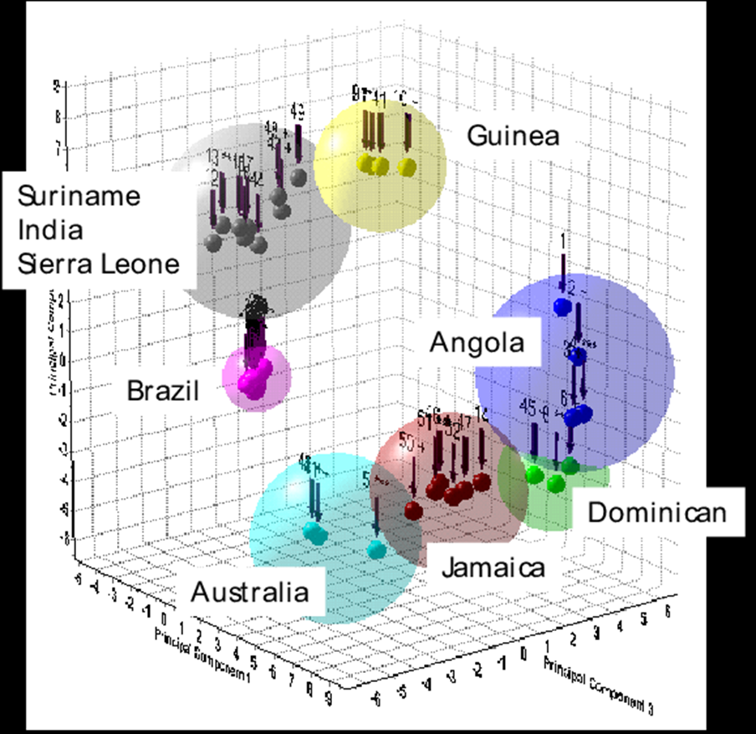
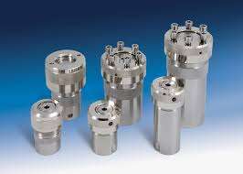
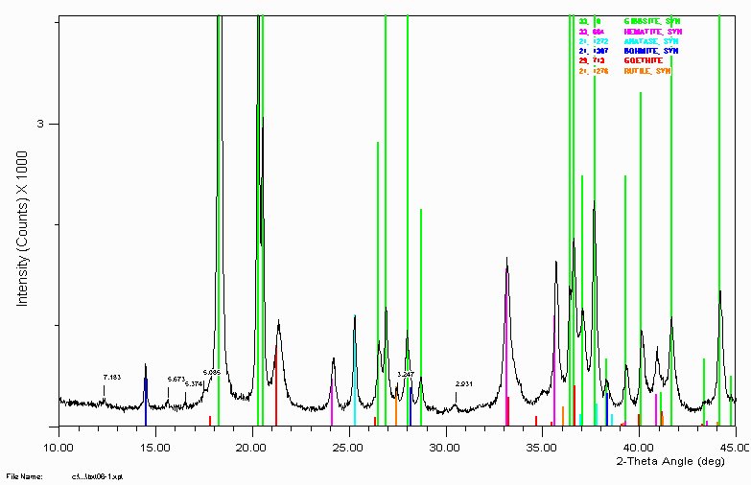
Bauxite Characterisation: All bauxites are different
Comprehensive chemical analysis:
Major, minor and trace elements
Available Alumina and Reactive Silica (low and high temperature)
Total inorganic and organic carbon
Extractable oxalate and other specific organics as required
Mineralogical phase analysis:
Semi-quantitative analysis of major phases
Quantitative analysis of quartz, boehmite and other phases if required
Reference Samples
Preparation and Certification of reference samples as:
Analytical reference standards
Marketing samples

Slide 4
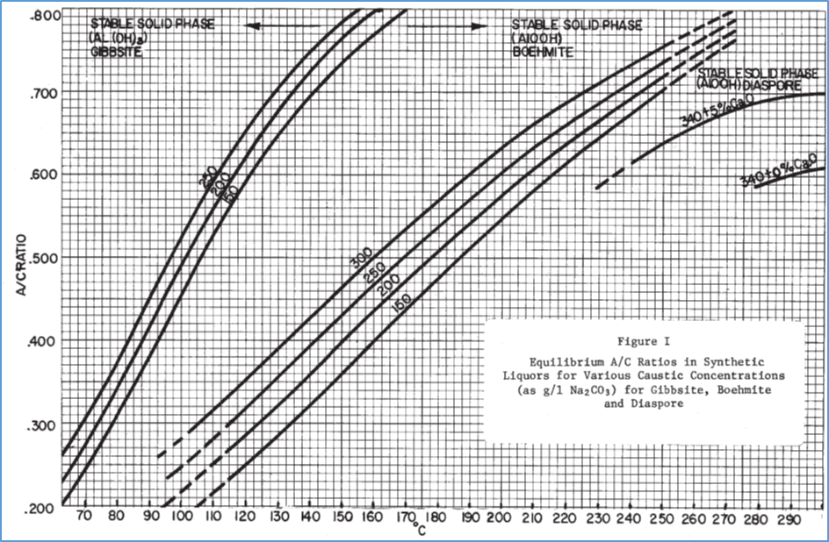
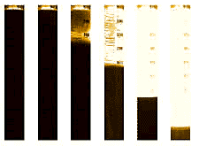
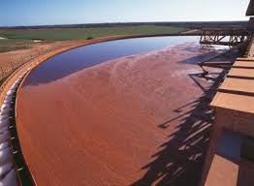
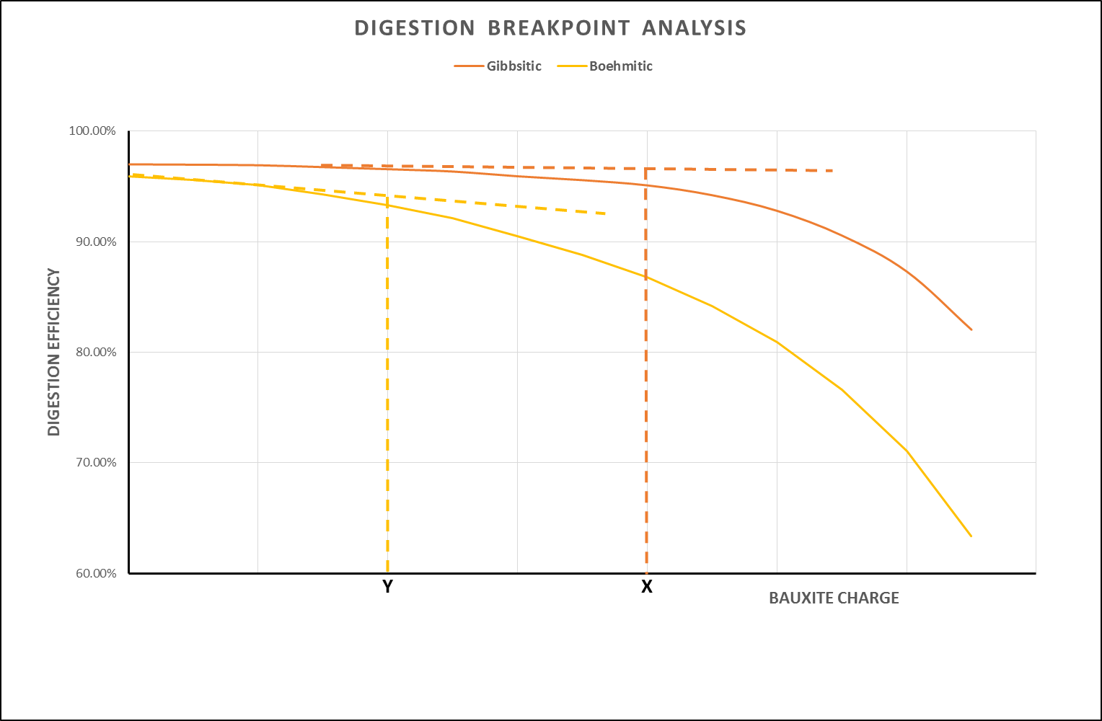
Processability Evaluation
Predicting bauxite behaviour
Chemical and mineralogical analysis tells only part of the story
Laboratory processabity tests indicate behaviour in refinery
Boutique tests tuned to customer needs
Desilication
Digestion Efficiency (breakpoint) (Lo Temp and Hi Temp)
Mud Stability
Mud Settling (flocculation, clarity, sediment density)
Filtration
Impurity Extraction

Slide 5
To find out more
Contact:
Visit our website:
Dr Greg Power
Director
Arriba Consulting Pty Ltd
PO Box 975 Canning Bridge
Applecross WA 6153
(TEL/)MOB +61 (0)410 469 400 GMT +8 Hrs.
EMAIL greg.power@arribaconsulting.com.au
www.arribaconsulting.com.au

